Slide 1

RIDPMS
A Platform which decreases the distance between the Citizens and the Government..

Slide 2
What’s our story?

Slide 3
Brainstorming
Existing manual system keeps development dissatisfying
Corruption.
Citizens engagement.
Transparency.
Hidden project activities.
Complex dependency of hierarchy.

Slide 4
Users and Features
Tasks to perform:-
Nearest project in your area
Search Location
Project Details
-Images , maps
-Project Members
-Deadline , Cost
Poll activities
Result
- via the SAR process.
Reputation based leaderboard.
Badges based Tax Rebate options.
Who are the users –
Citizens
Authorities

Slide 5
Feasibility Test
Manual solution.
Automatic data handling.

Slide 6
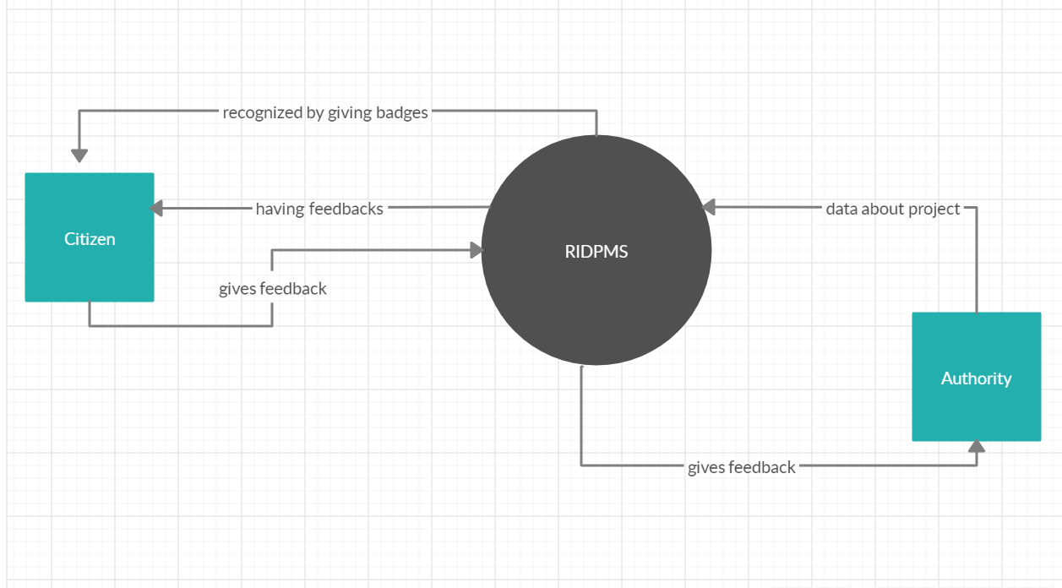
Context level DFD

Slide 7
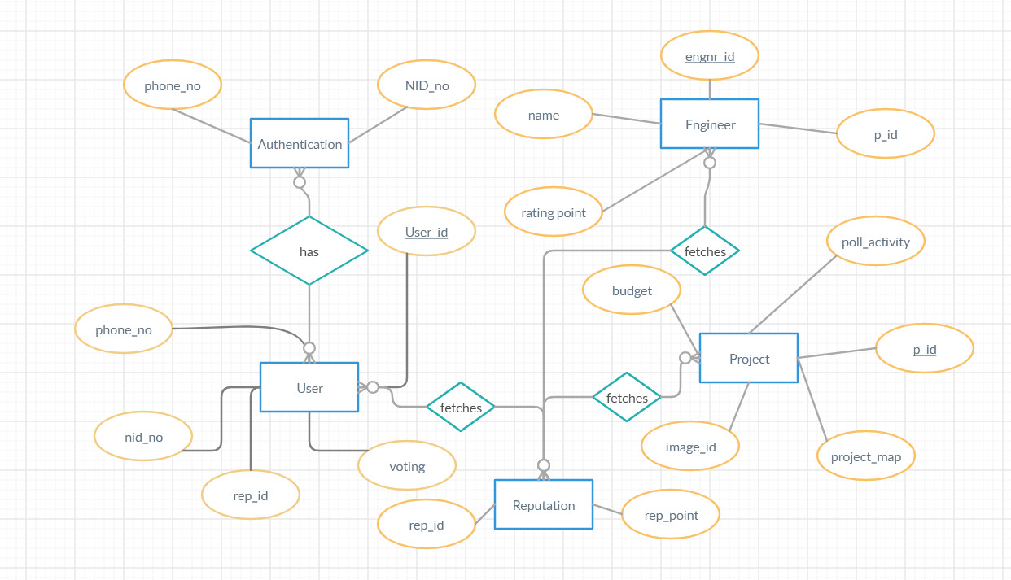
ER Diagram

Slide 8
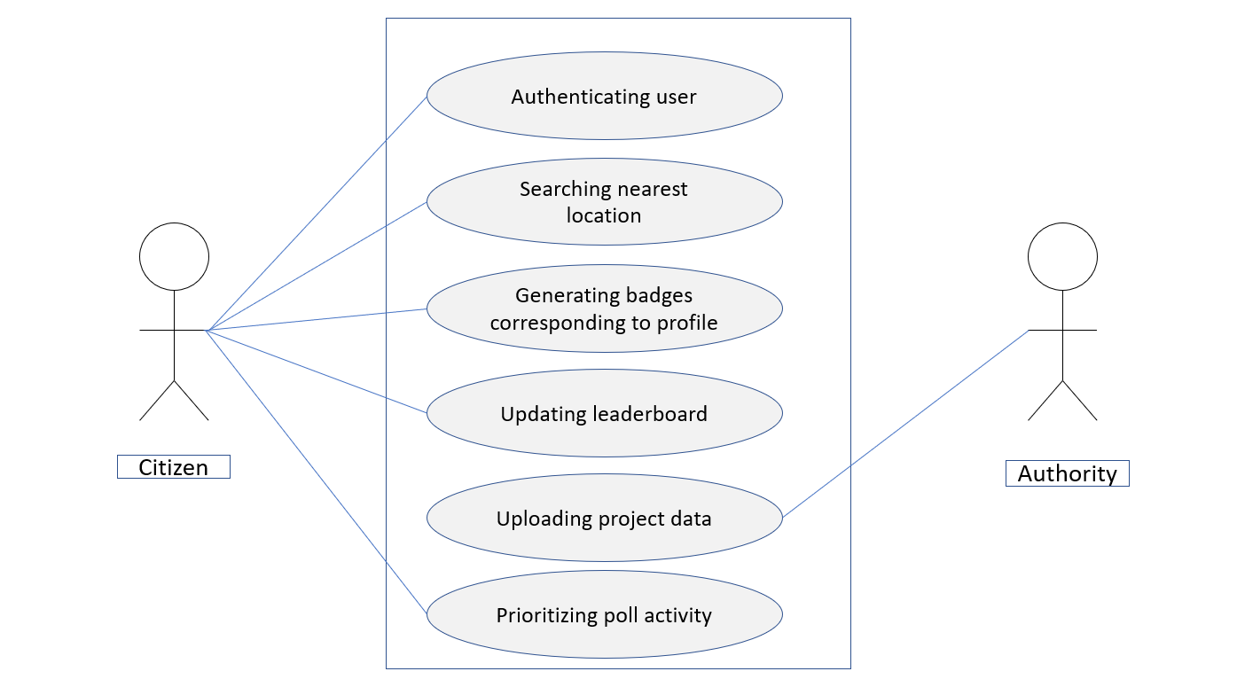
Use Case diagram

Slide 9
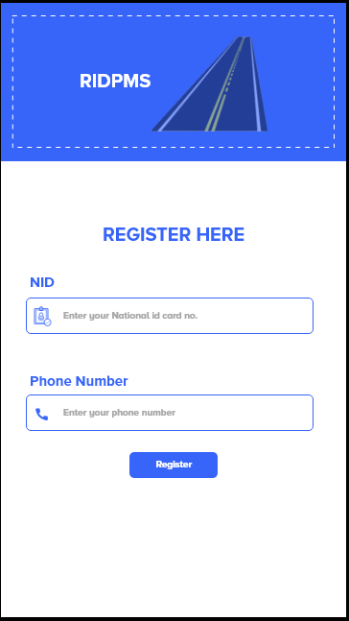
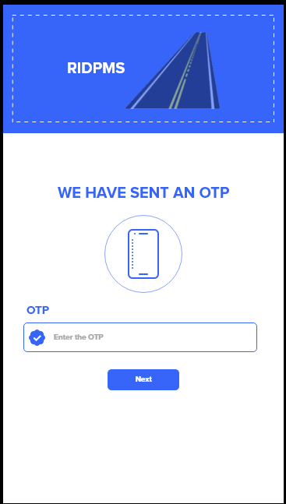
Prototype
Log in page
OTP validation

Slide 10
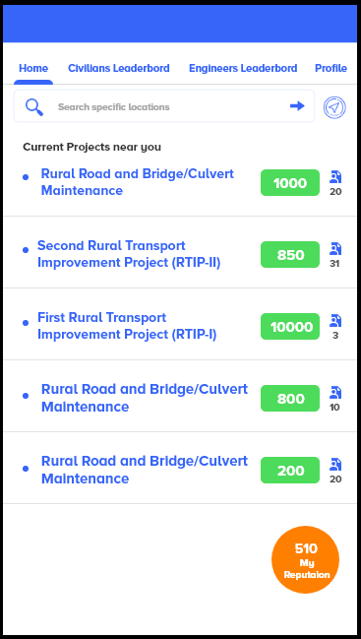

Prototype
Home Page
Project details

Slide 11
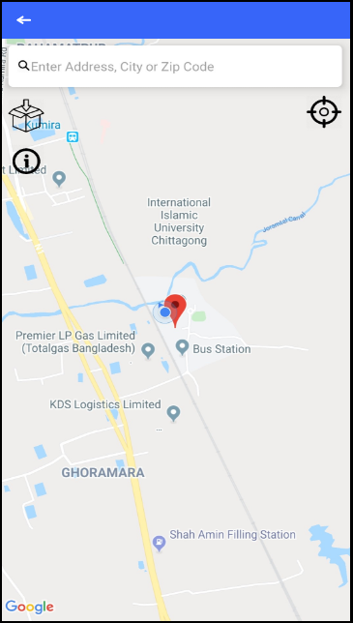
Prototype
Search location
Project details

Slide 12
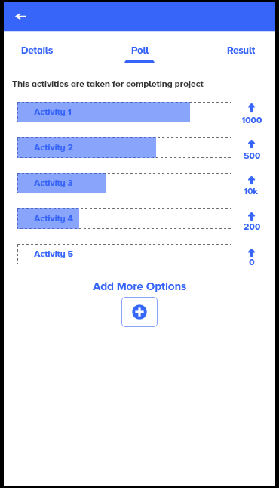
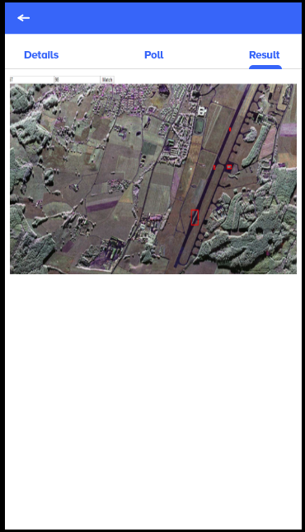
Prototype
Poll
Result

Slide 13
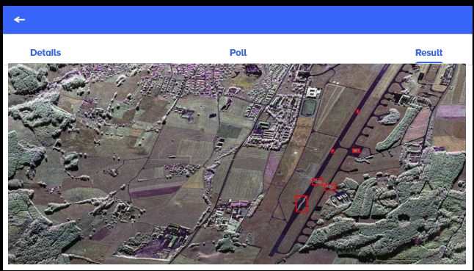
Prototype
Result

Slide 14
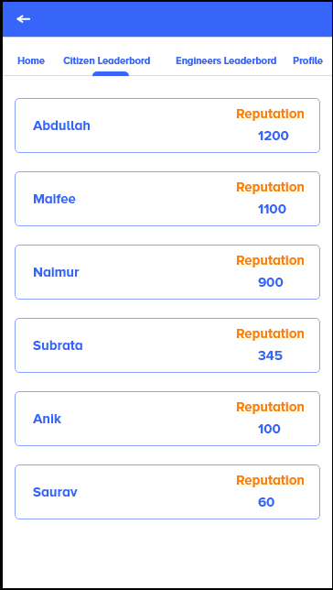
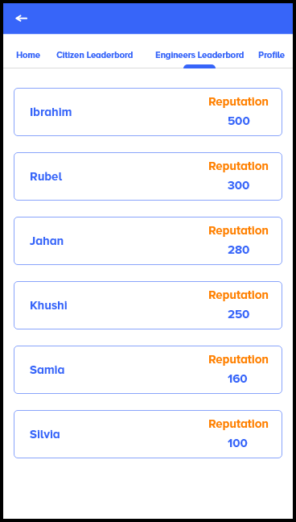
Prototype
Citizens leaderboard
Engineer’s leaderbord

Slide 15
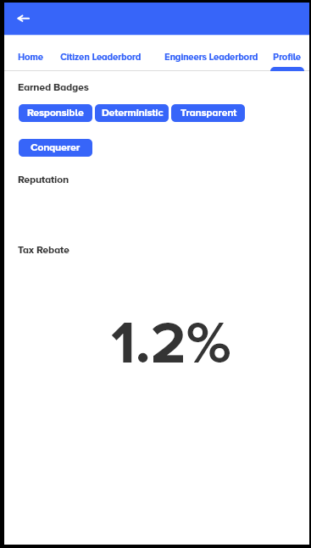
Prototype
Profile

Slide 16
REPUTation calculator
If any user up votes on a poll, his reputation will be added to that poll.
If that poll receives his reputation what will the user get?
We have created a simple algorithm for that.
First we divide total reputation by number of civilians involved in the poll. Then we multiply that value by civilian ranking index, if SAR verification shows that the project is successful, then user is actually involved in good activities. So that reputation will be added to the user. Else the reputation will be deducted.
Same procedure is applied for authorities.
What they can do with these reputation?
We are running the government by providing tax, what about some refund.

Slide 17
REPUTation calculator
Citizen | Index (Highest rep considered 1)
User1 | 1(1000)
User2 | .8(800)
User3 | .45(450)
Authority | Index (Highest rep considered 1)
Eng1 | 1(5000)
Off1 | .4(2000)
Let’s consider in a poll user1 and user3 have voted. There were two polls. User1 voted for both poll and user3 just for the second one.
So the poll total gained reputation of 2450.
Number of citizen involved 2.
If SAR verifies, then user1 will gain (2450)/2*1, else this amount will be deducted.
And the user3’s rep change will be (2450/2)*.45
So for authorities.

Slide 18
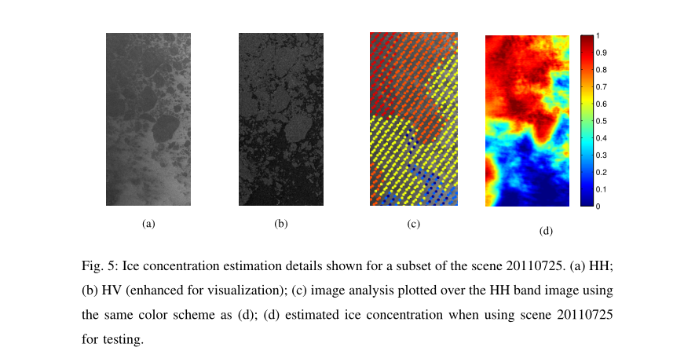
What’s SAR?
Synthetic-aperture radar
Ice concentration estimation from
dual-polarized SAR images using deep
convolutional neural networks
Lei Wang, Student Member, IEEE, K. Andrea Scott, Member, IEEE, Linlin
Xu, Member, IEEE, David A. Clausi, Senior Member, IEEE

Slide 19
Our Future Plan

Slide 20
Thank You
for your patience and attention.

